Slide 1



Patient Care Coordination 2017 Domain Update
Presented by:
Laura Langford
Amit Popat

Slide 2
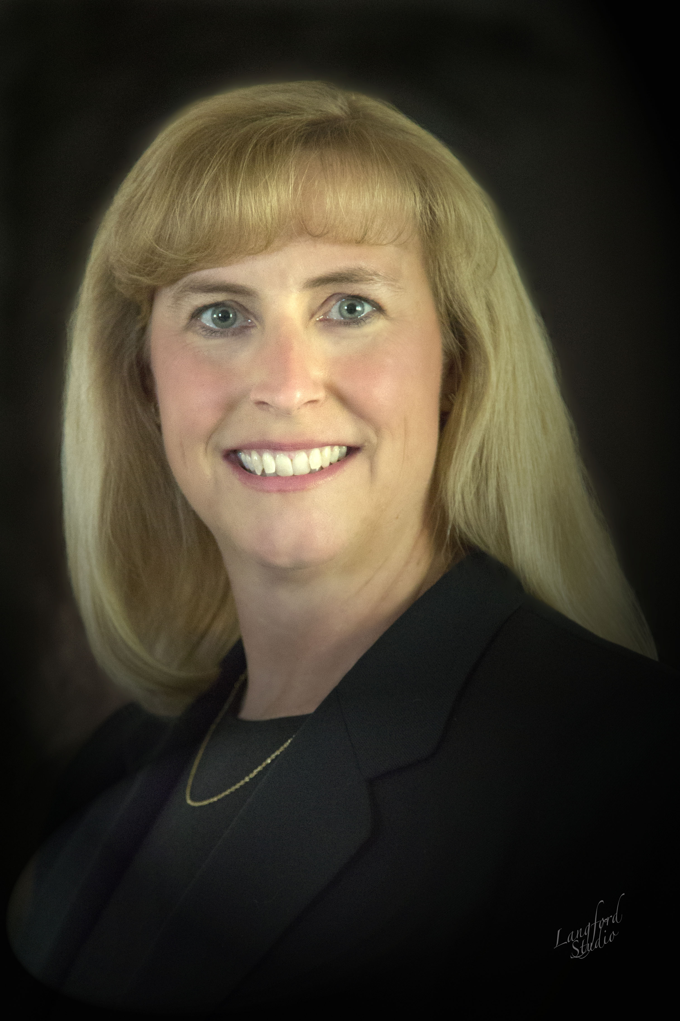
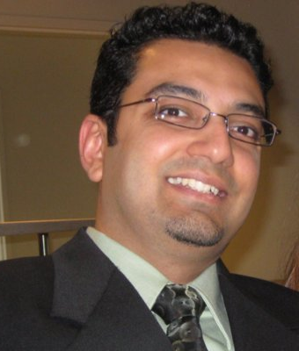
Today’s Presenters
Laura Langford, PhD, RN
Planning Committee Co-Chair, IHE PCC
Nursing Informatics, Intermountain Healthcare
Amit Popat
Planning Committee Co-Chair, IHE PCC
Epic

Slide 3
Learning Objectives
Describe the history of the PCC domain.
Explain the vision, mission, and strategic goals of PCC and its relevance in IHE and health IT.
Describe the work accomplished by PCC over the most recent annual work cycle.
Identify opportunities for your organization to participate in PCC domain activities and understand how to get engaged.

Slide 4
Today’s Agenda
Overview and History
Vision and Mission
Strategic Goals
Profiles and Technical Frameworks
Key Existing Profiles
New Profiles
How to Participate
Q&A

Slide 5
12 IHE Domains
Dental
2010
Radiology
1998
Pharmacy
2009
Cardiology
2004
Quality, Research, and Public Health
2006
IT
Infrastructure
2003
Radiation
Oncology
2004
Eye Care
2006
Pathology and Laboratory Medicine
Endoscopy
Patient Care
Coordination
2004
Patient Care
Devices
2005
Notes:
Mention this webinar is focused on PCC, for more general info on IHE International and it’s mission and vision see ihe.net

Slide 6
PCC History
Formed in 2004
Sponsors:
American College of Physicians (ACP)
Healthcare Information and Management Systems Society (HIMSS)
Cross-Enterprise Sharing of Medical Summaries (XDS-MS)
First PCC profile and first IHE content profile
Delivered in 2005 for Trial Implementation
Profiles delivered since:
23 content profiles
9 integration profiles
7 workflow profiles

Slide 7
PCC Vision and Mission
Vision:
To continually improve patient outcomes through the use of technology connecting across healthcare disciplines and care paths
Mission:
To develop and maintain interoperability profiles to support coordination of care for patients where that care cross providers, patient conditions and health concerns, or time.
http://wiki.ihe.net/index.php?title=Patient_Care_Coordination
Notes:
Completed vision casting at 2014 Summer F2F meeting
Vision key words: continually, across

Slide 8
PCC Strategic Goals
Content
Coordinate with external standards development organizations (SDOs) to develop and promote the use of content templates
Develop strategies to support multi-level content template guidance to benefit the global community
Workflow
Develop new profiles by reaching outward to other IHE domains to coordinate workflows across care paths
Develop white papers exploring new areas that could benefit from standards-based interoperability guidance
Nursing
Examine and understand the benefit of Ihe profile work in the nursing space by partnering with nursing organizations and initiatives
Develop profiles and white papers to support and explore various nursing specific workflows
http://wiki.ihe.net/index.php/PCC_Roadmap
Notes:
Mention example of eHEX Testing Workgroup alignment
Content:
re-evaluating our role here
Workflow:
proactive in working with other domains
4 profile proposals received in 2014 that were “cross-domain”
1 profile proposal in 2015 was cross domain
Nursing
History of subcommittee
Nursing needs related to care coordination and MU objectives

Slide 9
PCC Scope
General clinical care aspects
Order processing
Coordination with other specialty domains
Patient perspective
Clinician perspective
Workflows and integration needs that are common to multiple specialty areas
Document exchange
Clinical message exchange
Clinical reconciliation

Slide 10
PCC National and International Presence
Region | Country | Roles | Additional Information
Europe | France | Implementer Developer | http://esante.gouv.fr/en/actus http://www.ihe.net/uploadedFiles/Content/case_study_france_ehr.pdf Obestetric use cases, others
 | Italy | Implementer Developer | http://www.consorzioarsenal.it/web/guest Workflow definition profiles (XDW-based)
North America | US | Implementer Developer | http://www.siframework.org/ https://www.healthit.gov/ Data Access Framework National Extension, MU
 | Canada | Developer
Asia | China | Implementer | http://www.ncbi.nlm.nih.gov/pmc/articles/PMC3243277/
Middle East | Saudi Arabia | Implementer | Medications, immunizations, eReferral
http://ihe.net/IHE_Worldwide/
Notes:
http://wiki.ihe.net/index.php/Korea_Connectathon_2016
Hand off to tone

Slide 11
Profiles and Technical Frameworks
Profiling Approaches
Content
Structuring clinical or financial content
Uses Content Creator, Content Consumer actors
CDA, FHIR
Integration
Interaction between two systems
Uses a variety of actors and transactions
HL7v3, FHIR, etc.
Workflow
Interaction between a patient and multiple providers
Cross-domain

Slide 12
Profiles and Technical Frameworks
Pink= Perinatal
Green = Emergency Care
Blue= Nursing and Care Coordination
23 Content Profiles
Antepartum Education (APE)
Antepartum History and Physical (APHP)
Antepartum Laboratory (APL)
Antepartum Summary (APS)
Composite Triage Note and Nursing Note (CTNN)
Cross-enterprise Sharing of Medical Summaries (XDS-MS)
ED Physician Note (EDPN)
Emergency Department Referral (EDR)
EMS Transfer Summary (EMS)
eNursing Summary (ENS)
Immunization Content (IC)
Interfacility Transport Summary (ITS)
Labor and Delivery History and Physical (LDHP)
Labor and Delivery Summary (LDS)
Maternal Discharge Summary (MDS)
Multiple Content Views (MCV)
Newborn Discharge Summary (NDS)
Nursing Note (NN)
Patient Care Plan (PCP)
Patient Plan of Care (PPoC)
Personal Health Record (XPHR)
Postpartum Visit Summary (PVS)
Triage Note (TN)

Slide 13
Profiles and Technical Frameworks
Pink= Perinatal
Green = Emergency Care
Blue= Nursing and Care Coordination
13 Integration Profiles
Bed Management (BED)
Clinical Mapping (CMAP)
Guideline Appropriate Ordering (GAO)
Query for Existing Data (QED)
Query for Existing Data for Mobile (QEDm)
Referral/Order Linking (ROL)
Dynamic Care Planning (DCP)
Dynamic Care Team Management (DCTM)
Reconciliation of Clinical Content and Care Providers (RECON)
Request for Clinical Guidance (RCG)
Retrieve Clinical Knowledge (RCK)
Point-of-care Medical Device Tracking (PMDT)
Routine Interfacility Patient Transport (RIPT)

Slide 14
Profiles and Technical Frameworks
Pink= Perinatal
Green = Emergency Care
Blue= Nursing and Care Coordination
7 Workflow Profiles
Cross-enterprise Basic eReferral Workflow Definition (XBeR-WD)
Cross-Enterprise Cardiovascular Heart Team Workflow Definition (XCHT-WD)
Cross-enterprise TeleHome Monitoring Workflow Definition (XTHM-WD)
Cross-enterprise Tumor Board Workflow Definition (XTB-WD)
Perinatal Workflow (PW)
Remote Patient Monitoring (RPM)
Care Management (CM)
Notes:
- Reference ongoing work in IHE re Workflow Workshop

Slide 15
Profiles and Technical Frameworks
Early Content Profiles
Medical Summaries (XDS-MS)
Discharge and Referral Summaries exchanged between providers
EHR, HIS, HIE
Transitions of care between inpatient and ambulatory settings
Emergency Department Referral (EDR)
Enhances XDS-MS to support “Heads-up” call to ED
EHR, EDIS, HIS, HIE
Provides critical data needed in ED visits
Exchange of Personal Health Records (XPHR)
Exchange clinical summary data between patients and providers
EHR, PHR, Patient Portal
Ensures patients have updated lists of healthcare providers, problems, medications, allergies, immunizations, lab results, procedures, and encounters

Slide 16
Profiles and Technical Frameworks
Existing Clinical Decision Support Profiles
Query for Existing Data (QED)
Access to clinical data
EHR, CDR, HIS, Registries
For use in quality measurement, reporting, clinical decision support, and research
Care Management (CM)
Supports communication to specialized care delivery systems for disease management
Request for Clinical Guidance (RCG)
Access to clinical decision support as a service
EHR, other HIT systems
Retrieve Clinical Knowledge (RCK)
Interface for health IT systems, Personal Health Records, and HIEs to retrieve knowledge on a topic suitable for presentation to a clinician or patient

Slide 17
Profiles and Technical Frameworks
Existing Cross Domain Profiles*
Profile | Domain | Description
Remote Patient Monitoring (RPM) | Patient Care Devices (PCD) | Standardizes measurements taken by personal healthcare devices in remote settings
Clinical Mapping (CMAP) | Patient Care Devices (PCD) | Manages nomenclature transformations mapping to and from clinical terminologies
Cardiovascular Heart Team Workflow Definition (XCHT-WD) | Cardiology (CARD) | Facilitates management of a dynamic Heart Team supporting decisions typically made in cardiology care
Perinatal Workflow (PW) | Radiology (RAD) Laboratory (LAB) Patient Care Devices (PCD) Quality, Research, and Public Health (QRPH) | Simplifies exchanges between various providers of perinatal care by utilizing profiles and transactions from several IHE domains to support the continuum of care of expectant mothers and newborns
Guideline Appropriate Ordering (GAO) | Radiology (RAD) | Provides appropriateness guidance to systems utilizing decision support interoperability
*Does not represent ALL profiles with cross-domain dependencies

Slide 18
New Profiles
2017 Patient Care Coordination
http://ihe.net/Technical_Frameworks/#pcc

Slide 19

Point-of-Care Medical Device Tracking (PMDT)
PROBLEM
VALUE PROPOSITION
Implantable medical devices are costly and concerns about illegitimate (i.e., counterfeit, stolen) products has become a global issue
Post-market surveillance of implantable medical devices can be challenging
Implantable medical device adverse events and recalls pose a patient safety issue
Acquiring medical device data used at the point-of-care is difficult to retrieve for reuse at a later time
Closes the loop on data acquisition at the point-of-care to support reporting of medical device data
Medical device data used for:
Continuum of care (e.g., Discharge Summary, Referrals)
Registries (e.g., Total Joint Registry)
Payers (e.g., government provided, private insurance)
Can associate a medical device used for monitoring a disease or symptom of a disease (e.g., vital sign monitors, pulse oximeters, blood glucose monitors) to a patient for querying the device or procedure using the UDI
Increase patient safety
Traceability of medical devices (avoid use of counterfeit or illegitimate products)
Quality issues identified (e.g., recalls, adverse events)
Increase accurate medical device data capture at the point-of-care
Eliminates human error from manual medical device data entry

Slide 20

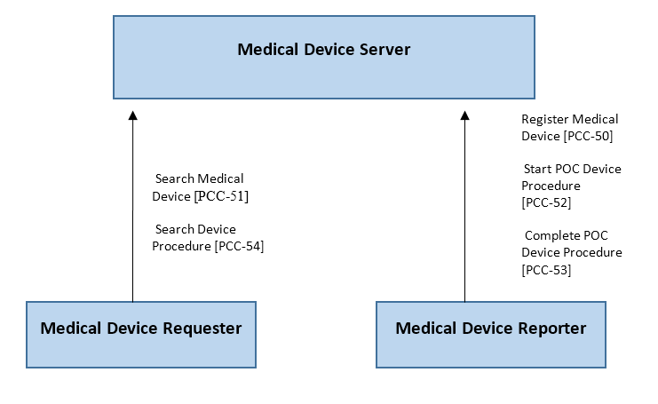



Actors and Transactions
Tracking Implantable Medical Devices and Tissues (e.g., Orthopedic, Cardiovascular, etc. )
PCC-50 + PCC-53
Track Procedures using a Medical Device (e.g., glucose monitor, vital sign monitor) at the point-of-care for accuracy
PCC-50
PCC-52
PCC-53
Query Procedures
PCC-54
Query Device Records
using UDI
PCC-51

Slide 21

PMDT Technical Highlights
Content Profiles use HL7 FHIR STU3 StructureDefinition Resources to record information about medical devices (including implantable/life-supporting/life-sustaining device and tissues that use US FDA UDI)
Device Resource
Procedure Resource – to document procedures using focal devices
and references to Patient
FHIR uses RESTful services (HITTP/HTTPS) to create/update and query records
Provides new capabilities to the point-of-care systems to enhance patient safety and effectiveness
Tracking device use in the context of procedures and associating medical devices and POC procedures with the correct patient record
Managing identity information for devices and patients at the point-of-care
Supports US FDA UDI and transitions
Both human-readable(i.e., manually entered or processed) and AIDC (i.e., scanned) using ASCII and extended character sets.

Slide 22
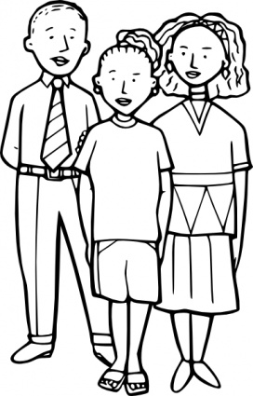

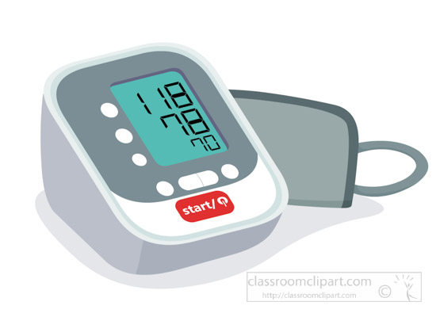



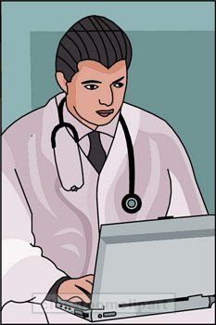

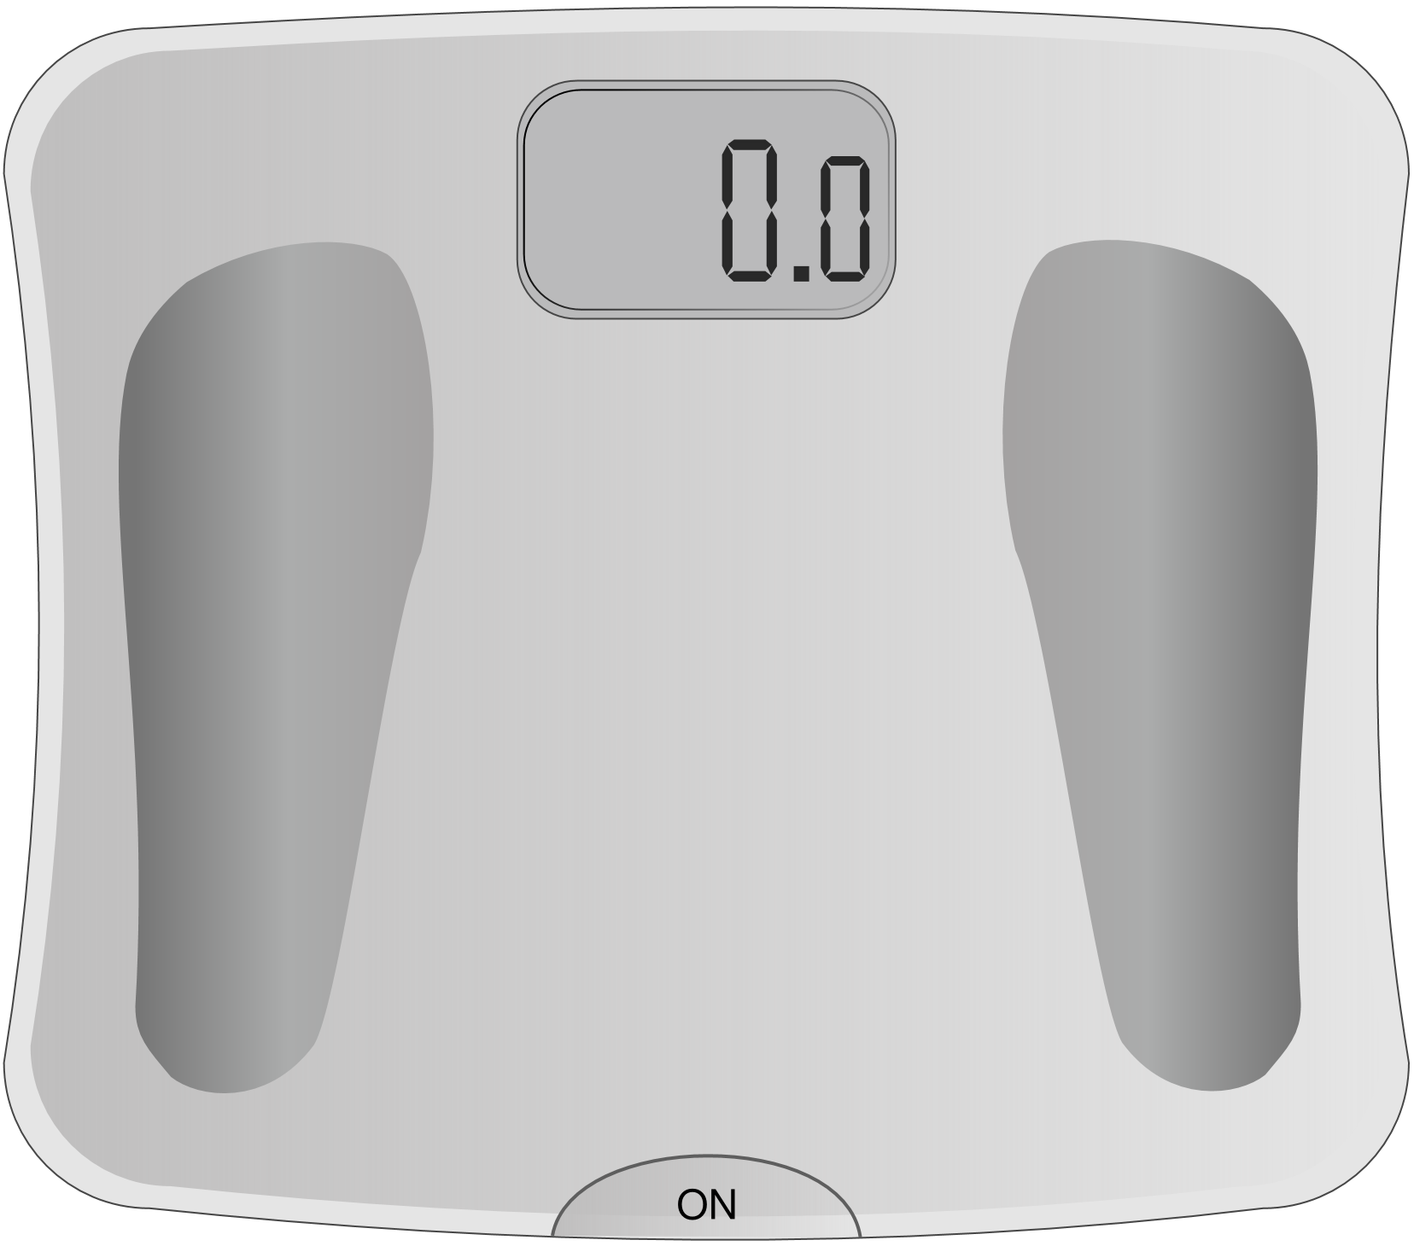

Remote Patient Monitoring Allows Health Care Professionals to Monitor Patients from their Homes

Slide 23







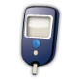




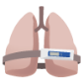
Standardized Medical Devices send measurements via local transports

Slide 24

Standardized Local Gateways collect the measurements and optionally add some Patient Info
Dedicated Settop Box
Mobile Phone
Personal Computer

Slide 25
Gateways format the data to FHIR or PCD-01 and send to Backend Consolidator or direct to Repository
FHIR server
XDSb repository
To PHMR
Consolidator

Slide 26
Health Care Professional Reads Data with a Remote Patient Monitoring application

Slide 27
Dynamic Care Team Management (DCTM)
The Dynamic Care Team Management (DCTM) Profile provides a mechanism to facilitate system interactions to support care team membership:
Discovering Care Teams
Creating/updating Care Teams
Listing Care Teams

Slide 28
DCTM Details
Provides the structures and transactions for care team management and sharing information about Care Teams that meet the needs of many, such as providers, patients and payers.
Depicts how information about multiple care teams can be shared and used to coordinate care.
Care Teams can be dynamically updated as the patient interacts with the healthcare system.
A patient and providers may be associated with multiple types of care teams at any given time.
Standards
HL7 FHIR CareTeam and Subscription resources
HL7 Coordination of Care Services (CCS) Functional Model

Slide 29
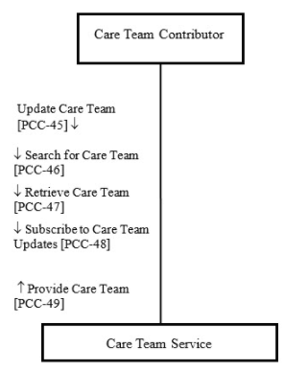
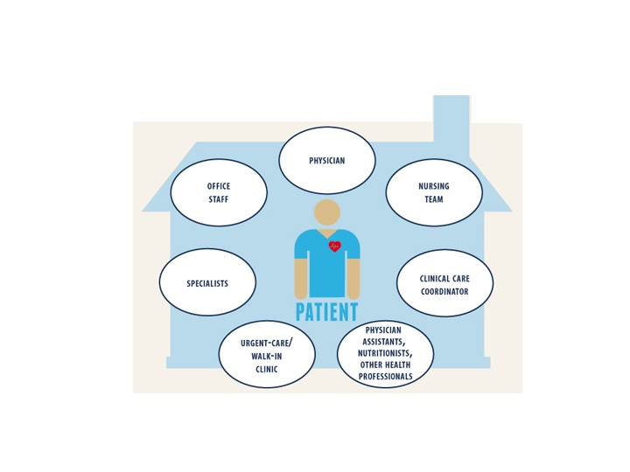
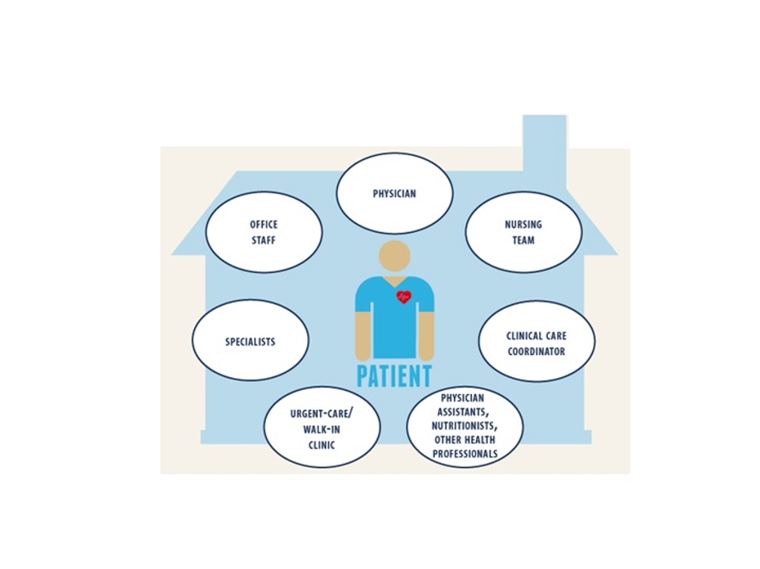
DCTM Actors and Transactions
Notes:
In Summary
DCTM enables effective care planning and collaboration between applicable care team members and the patient.

Slide 30
QEDm Integration Profile
The Query for Existing Data for Mobile (QEDm) profile supports lightweight dynamic queries for clinical data elements including vital signs, problems, medications, immunizations, diagnostic results, procedures, visit history etc...
The profile is conceived to be implemented by application specific to ‘mobile devices’.
The solution is based on a standardized query interface to health (HTTP-based RESTful APIs) and the resulting transaction can be used to query for lists of specific data elements, represented as HL7 FHIR resources.
QEDm may be used stand-alone or combined within mXDE (Mobile Cross-enterprise Document Data Elements Extraction).
Notes:
Read the slides. On the last bullet, add that this profile is in Trail Implementation by IHE as it relies on HL7® FHIR® STU 3 Resources which maturity is at FMM Levels 2 through 5, which have not yet reached the standards level set at 6.

Slide 31
QEDm Actors
No new actors (reusing existing Clinical Data Consumer and the Clinical Data Source):
One new transaction Mobile Query Existing Data [PCC-44]:
• It allows to query for clinical fine grained data elements that satisfy a set of parameters by using the HL7 FHIR query framework. The result of the query is a FHIR Bundle containing FHIR clinical data Resources that match the query parameters.
Based on the supported options, the Clinical Data Consumer may query and the Clinical Data Source may return data elements among: Allergies and Intolerances, Conditions, Diagnostic Results, Encounters , Immunizations, Medications, Observations, Procedures
With the Document Provenance option, the Clinical Data Consumer may fetch the FHIR clinical data Resource(s) together with Provenance Resources referencing(s) the original Document from which it was extracted (“one click access” to clinical context).
Notes:
The design of QEDm is quite simple with two Actors (same as in QED which is HL7V3 based) Read the rest.

Slide 32
QEDm Actors and Transaction: Options & Flow when combined with mXDE
mXDE Data Element Provenance
Consumer
XDS/MHD Document
Consumer
Retrieving the original Document by using the Provenance’s links
CDA
QEDm Clinical Data Consumer
QEDm Clinical Data Source
Clinical Data Consumer
Provenance Option
Simple Observations Option
Allergies and Intolerances Option
Conditions Option
Diagnostic Results Option
Medications Option
Immunizations Option
Procedures Option
Encounters Option
Mobile Query Existing Data
Clinical Data Source
Provenance Option
Simple Observations Option
Allergies and Intolerances Option
Conditions Option
Diagnostic Results Option
Medications Option
Immunizations Option
Procedures Option
Encounters Option
mXDE Data Element Extractor
Accessing Data Elements with Provenance
Notes:
This is an animated slide one shows the operation of QEDm in the context of the mXDE Profile.
On the initial display, one focusses on QEDm with its two Actors shown with the list of “content” Options available.
On the second click, an example of a QEDm Mobile Query Existing Data transaction, queries specifically for Observations, Allergies, Conditions, Medications and Immunizations.
Those clinical data elements are extracted from a source CDA Document, shown as data elements (orange dots) returned to the QEDm Clinical Data Consumer (third click) along with the Provenance Resource (green dot).
On the fourth click, the application supporting the Clinical Data Consumer, leverages the reference from the Provenance Resource ( as defined by the mXDE Data Element Provenance Actor) to retrieve the original source document from which the returned data elements where extracted.
In summary, with QEDm and its integration with XDS and the FHIR based document sharing MHD as specified by the new mXDE Profile, IHE has combined the respective strengths of the document based health information sharing and the resource API based health information access.

Slide 33
360 Exchange – Closed Loop Referrals (360X)
Clinical Information
Workflow
Transport
HL7 V2 messages
XDM (required)
XDR (optional)
XDS-MS/XPHR Option
C-CDA 2.1 Option
Notes:
This profile provides structures and transactions for closing the loop of information sharing between a Referral Initiator and a Referral Recipient, using point-to-point transactions. The main use case is in the ambulatory setting, with referrals from a PCP to a specialist.
The profile specifies three layers for managing a closed loop referral.
The transport layer is built upon the ITI XDM profile, with the ZIP over Email and ZIP Over Email Response options. In addition to the XDM transport, XDR and MHD are also available as two additional options. The XD Metadata constructs help future-proofing the profile in several ways:
Additional Document Entries can be added to the existing Submission Set packages (e.g., images, PDF files of EKGs)
Additional communication options can be added, both additional “push” messages via XDM, XDR or MHD, or queries via XCA or XDS
Alignment with future standards, in particular FHIR, where the metadata is natively represented, and workflow management is under development.
The Workflow layer, which is necessary to convey the referral-specific information, uses HL7 Version 2.5.1 messages (with some pre-adoption from HL7 Version 2.9 elements). This also provides for future expansion without drastic changes to the profile (e.g. providing insurance-specific information within existing segments in the HL7 message). Another possible slight variation of the profile could also employ the HL7 messages as the transport/metadata layer, enabling its use within the enterprise, similar to the Radiology Scheduled Workflow or Lab Scheduled Workflow profiles.
The Clinical Information layer uses HL7 CDA documents to convey the clinically relevant information from Referral Initiator to Referral Recipient. The two options are
Use IHE defined document templates (XDS-MS Referral Note for the referral request, and XPHR for the referral outcome)
Use appropriate HL7 Consolidated CDA (C-CDA) version 2.1 document templates

Slide 34
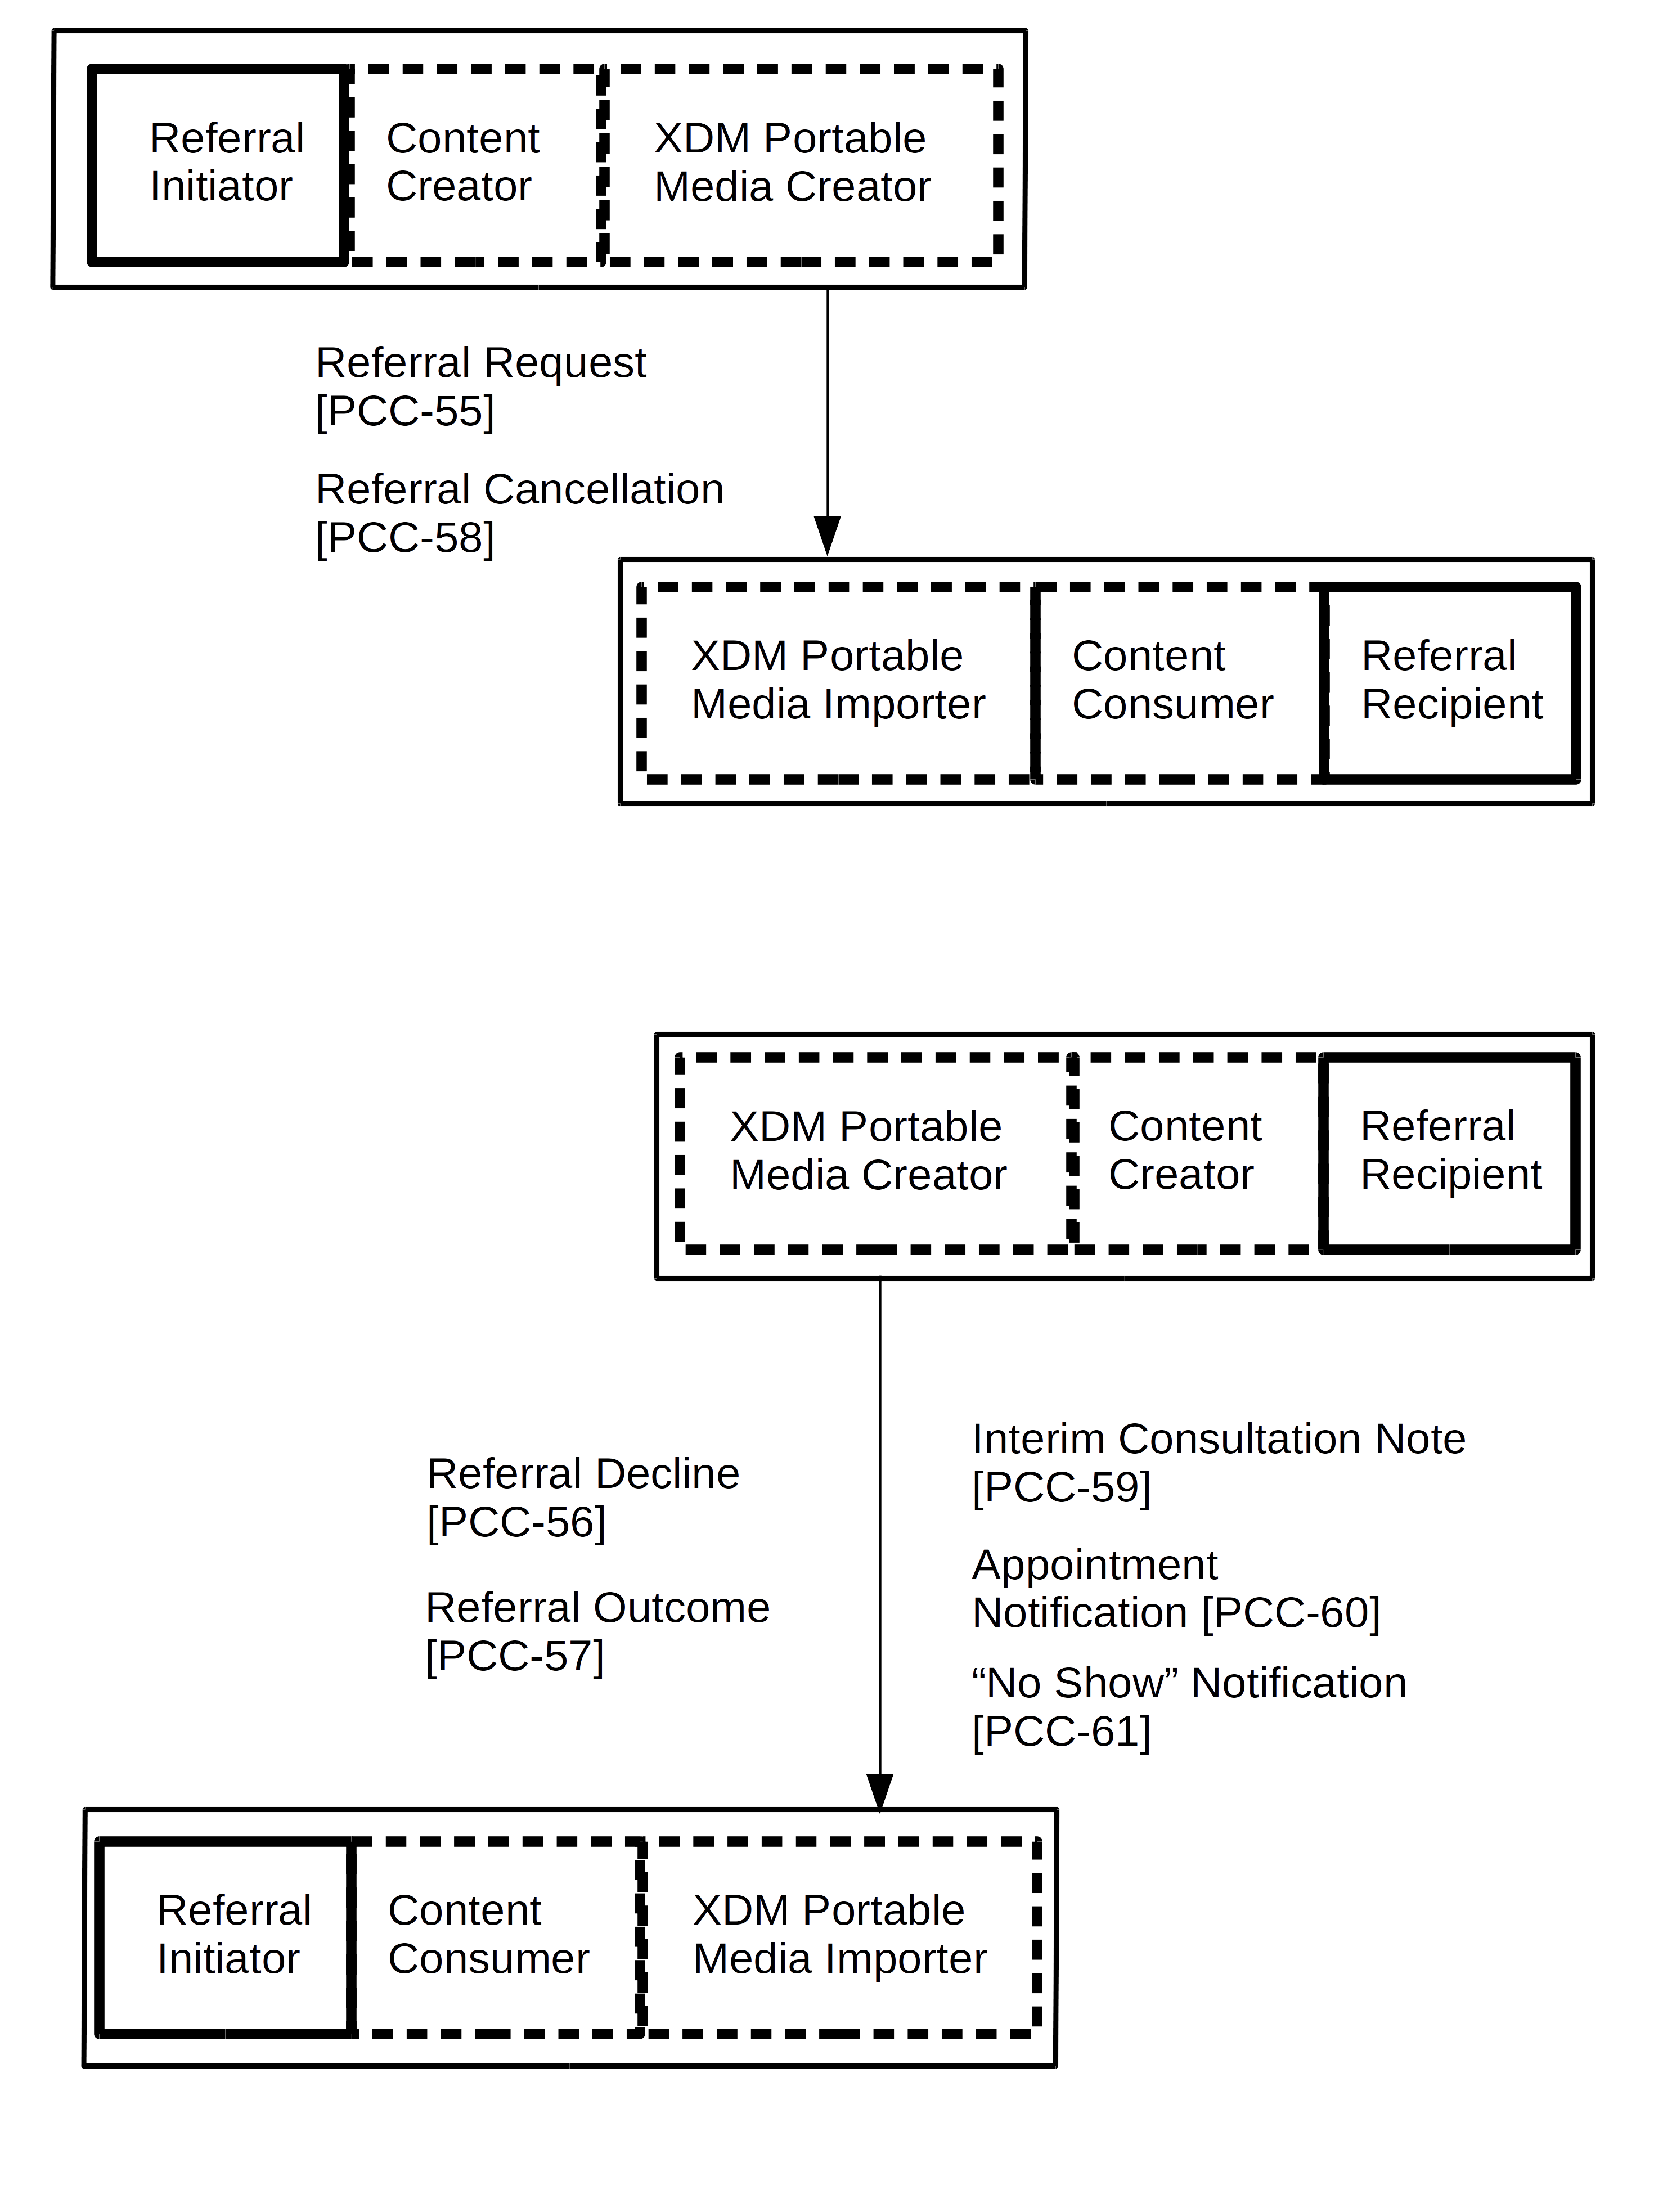
360 Exchange – Closed Loop Referrals (360X)
Actors:
Referral Initiator
Referral Recipient
Transactions:
Referral Request
Referral Outcome
Referral Decline
Referral Cancelation
Interim Consultation Note
Appointment Notification
No-Show Notification
Notes:
The profile defines 7 transactions that allow the two actors. Referral Initiator and Referral Recipient, to coordinate the exchange of information during the referral process with varying degree of complexity. Five of the transactions represent possible workflow “paths” based on the clinical information shared between the Initiator and the Recipient, and the other two transaction are part of the Scheduling Option, which allows for a rudimentary sharing of appointment information as part of the referral process.
The “Happy Path”, which will probably account for most of the referrals, consists of the Referral Request and Referral Outcome transactions.
The Referral Request contains the clinical information provided by the Referral Initiator, including the reason for referral. It also includes the administrative information regarding the referral, such as a unique patient ID, unique referral ID, and any timing constraints or urgency of the referral. Part of the Referral Request transaction is the requirement for the Referral Recipient to either accept or decline the referral.
The Referral Outcome contains the clinical information that is the result of the referral, and the indication that the referral is complete. If the referral spans multiple visits with a specialist, then the Interim Consultation Note transaction can provide multiple clinical information over time.
The Referral Decline and the Referral Cancelation transactions allow the Referral Recipient and the Referral Initiator, respectively, to communicate exceptions in the workflow.
The Appointment Notification and the No-Show Notification transactions comprise the Scheduling option of the profile. In settings where appointment schedule sharing is not done via other means, this option allows for the basic information about an appointment scheduled as part of the referral to be communicated back to the Referral Initiator, including modifications and cancelations.

Slide 35
360 Exchange – Closed Loop Referrals (360X)
Clinical Information
Workflow
XDM Metadata
HL7 V2 messages
C-CDA
Direct
US National Extension
Use of Direct
C-CDA 2.1 for clinical information
Further reading
360X Supplement
360X Project Wiki
Notes:
In addition to the base profile, IHE USA has also produced a 360X US National Extension.
The original impetus for the profile came from the 360 Exchange Closed Loop Referral Project, supported by the ONC. The project goals are to keep the requirements for the information exchange within the existing requirements for Healthcare Information Technology as specified by MU2 and MU3.
The requirements for the National Extension are the use of Direct and XDM at the transport layer, and the use of C-CDA as the clinical information format.

Slide 36
Routine Inter-facility Patient Transport (RIPT)
The Problem
Need to inform transport care team of important patient information
Needs significant time to gather information needed for transport:
Verbal report
Signatures
Reading through extensive paper reports
Need to populate transport care record manually
Value Proposition
Benefit for both hospitals and EMS
Decreases EMS time spent doing paper handoff on floor
Increases bed availability
Improving throughput for Emergency Department (ED)
Notes:
Transport providers are unable to receive an electronic form of a patient's vital medical information
Resolution using a derivative of information available in CDA summary
Currently available in discharge systems
FHIR resources could be used to communicate this information
Between medical EHR systems and transport company systems
Benefits both hospitals and transport companies
decrease in time spent populating transport summery document
increase in bed availability
increase in Emergency department throughput in hospitals

Slide 37
RIPT Technical Solution
Transport Data Consumer
Transport Data Responder
Two approaches
CDA
FHIR
Query for Transport Data (PCC-62)
CDA document sharing transaction (RIPT)
FHIR Query Transaction
Content Creator
Content Consumer
Document Sharing
Notes:
The technical solutions have two solutions. One is to use CDA to retrieve the transport information.
The other way is to use a FHIR query to retrieve transport data

Slide 38





RIPT Using Document Sharing
Document Sharing
Routine Interfacility Patient Care Document
Medical Summary, etc…
Routine Interfacility Patient Care Document
Long Term Care
Hospital
E-Patient Care Record

Slide 39

RIPT Using Query (FHIR)
Medical Summary
Query For Transport Data (FHIR)
Hospital
Rehab Facility
E-Patient Care Record

Slide 40
PCC Participation
IHE International Membership
Apply for IHE International Organizational Membership
Membership information: http://ihe.net/join/
180+ members: http://ihe.net/Member_Organizations/
Modest annual fee
Participate in IHE Domains and Committees
IHE Organizational members only
12 clinical and operational domains
Each domain has one planning and one technical committee
Non-members may participate in comment periods and implement IHE Technical Frameworks
Notes:
- Speak to benefits of membership and active participation

Slide 41
PCC Participation
PCC Planning Responsibilities
Develops domain strategy and roadmap
Identifies domain priorities and problems
Recruiting new members
Educating implementers
Aligning industry initiatives
Review and recommends IHE profile proposals
ihe@himss.org
Co-chair: Amit Popat
Co-chair: Laura Langford (outgoing)
Co-chair: Emma Jones (incoming)
pccplan@googlegroups.com
Wiki page:
http://wiki.ihe.net/index.php/Patient_Care_Coordination_Planning_Committee

Slide 42
PCC Participation
PCC Technical Responsibilities
Development of IHE profiles
Maintenance of IHE Profiles and Technical Framework
Recruiting new members
ihe@himss.org
Co-chair: Denise Downing
Co-chair: Emma Jones (outgoing)
Co-chair: Gila Pyke (incoming)
pcctech@googlegroups.com
Wiki page:
http://wiki.ihe.net/index.php/Patient_Care_Coordination_Technical_Committee

Slide 43
PCC Participation
IHE Profile Development Cycle
Eighteen (18) month cycle
Profile proposals
Profile development
Public comment
Trial implementation and profile testing
Feedback and adjustment from testing
Domains have independent schedules
Opportunity for members and non-members to participate
Profile development
Public comment
Testing and implementation
Change proposals
Over of IHE Cycle (next slide) →

Slide 44


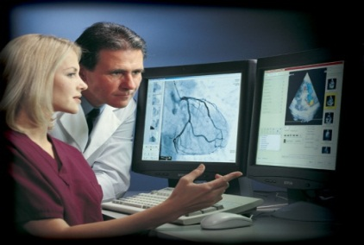
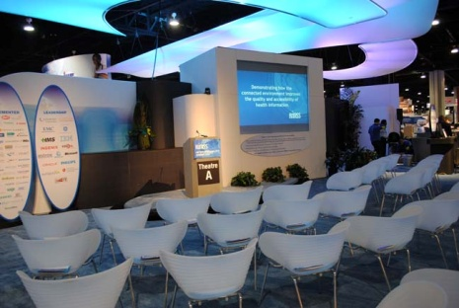

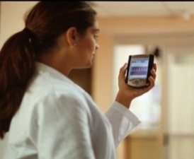
IHE Profiles Drafted & Revised
Test at IHE Connectathons
Trial
Implementation
Posted
Publish in IHE’s Product Registry
Published
For Public
Comment
months 14-18
Demonstrate at a
IHE Technical
Framework Developed
months 6-13
Profile Selection by Committees
IHE Improves, Safety, Quality and Efficiency in Clinical Settings
Install Interoperable products in Clinical Settings worldwide
IHE Call for Proposals Opens
months 1-5

Slide 45
PCC Participation
PCC Profile Development Schedule
IHE Profile Stage | Open Date |  | Close Date
Call for Proposals | Aug 2017 |  | Sep 2017
Profile Proposal Review and Selection | Oct 16-17, 2017 |  | Nov 15-16, 2017
Profiles Drafted in Technical Committee | Nov 2017 |  | May 2018
Public Comment | Jun 2018 |  | Jul 2018
Trial Implementation Published | Sep 5, 2017
IHE Connectathon Registration | Sep 5, 2017 | Oct 6, 2017
IHE Connectathon Testing | Jan 2018
http://wiki.ihe.net/index.php?title=ITI,_PCC_%26_QRPH_Meetings

Slide 46
PCC Participation
IHE Connectathon
IHE Connectathons are…
Held around the world
An unparalleled testing opportunities
Open for all to participate in
Held in Cleveland, OH for North America
IHE North America Connectathon registration opens in September!
http://www.iheusa.org/connectathon-registration.aspx

Slide 47
PCC Participation
Links and Resources
Resource | Url
IHE.net | http://ihe.net/Patient_Care_Coordination/
Webinar series posted online | http://ihe.net/webinars/
Sign up for IHE International News | Email secretary@ihe.net
General PCC Questions | Email ihe@pcc.net
Google Groups (members only) | https://groups.google.com/forum/#!forum/pcctech https://groups.google.com/forum/#!forum/pccplan
Apply for IHE International Membership | http://ihe.net/join
IHE Technical Frameworks | http://ihe.net/Technical_Frameworks/#pcc
IHE PCC Profiles (wiki) | http://wiki.ihe.net/index.php/Profiles#IHE_Patient_Care_Coordination_Profiles
IHE Connectathon Registration | http://www.iheusa.org/connectathon.aspx

Slide 48
Questions?

